Slide 1
Opportunity Zone Structure – Newport News
Greg Davis, CPA gdavis@cbh.com

Slide 2
Meet the Speaker
Greg Davis, CPA
Partner, Tax Services

Slide 3
U.S. Opportunity Zone Areas
CDFI - https://www.cdfifund.gov/Pages/Opportunity-Zones.aspx

Slide 4
Time to Elect Deferral of Gain
180 DAYS FROM SALE EVENT TO ELECT TO DEFER GAIN & FUND QO-FUND
PURCHASE 100% OF ASSETS, BUYER
XYZ, Inc.
(S-Corp)
100% STOCK OWNERSHIP
Qualified Opportunity Zone Fund
(QO-Fund)
180 DAYS FROM END OF CORPORATION OR PARTNERSHIP TAXABLE YEAR (12/31)
Buyer
TO DEFER GAIN & FUND QO-FUND (TAXPAYER MAY ELECT OUT AND FUND EARLY IF DESIRED)
Seller, Taxpayer
Notes:
The objective of the proposed Implementation Guide is to provide question and answer guidance to clarify, explain, or elaborate on the requirements of GASB Statement No. 75, Accounting and Financial Reporting for Postemployment Benefits Other Than Pensions, as amended, and GASB Statement No. 74, Financial Reporting for Postemployment Benefit Plans Other Than Pension Plans, as amended.

Slide 5
QOZ Sample Ownership Structure
70% OWNERSHIP
QOZ Fund
QOZ Business
Outside Investor

Slide 6
Investments in Qualified Opportunity Zone Business Property
QOF (Corporation or Partnership)
QOZB (Stock)
Qualified Opportunity Zone Business Property
QOZB (Partnership)
Investment Into Partnership Interest
Investment Into Stock
Invest Directly

Slide 7
Funding QOZ and ProjectCo
CANNOT INVEST IN ANOTHER QO FUND
QO Fund Will Have 180 Days From When Capital Came Into Fund
(1065 Partnership)
10,000,000
9,000,000
1,000,000
GAIN DEFERRED QO PROPERTY CASH SECURITIES,
OTHER INVESTMENTS
CANNOT INVEST IN ANOTHER QO FUND
CANNOT BUY STOCK/LLC INTEREST IN ANOTHER COMPANY
MUST DEPLOY CAPITAL WITHIN 31 MONTHS OF FUNDING
MUST HAVE WRITTEN PLAN FOR WORKING CAPITAL
70% OF TANGIBLE PROPERTY MUST BE QOZB PROPERTY
Defer 10,000,000 Gain 7/1/19
FUND PROJECT ENTITY WITH 9,000,000
Project Entity
(1065 Partnership)
Buyer
9,000,000
6,300,000
2,700,000
INVESTED
QO PROPERTY CASH SECURITIES,
OTHER INVESTMENTS
Notes:
The objective of the proposed Implementation Guide is to provide question and answer guidance to clarify, explain, or elaborate on the requirements of GASB Statement No. 75, Accounting and Financial Reporting for Postemployment Benefits Other Than Pensions, as amended, and GASB Statement No. 74, Financial Reporting for Postemployment Benefit Plans Other Than Pension Plans, as amended.

Slide 8
Comparison of Direct Investment vs. Indirect Investment
Requirement | Direct Investment | Indirect Investment
Percentage of Opportunity Fund’s assets that must be invested in qualified opportunity zone business property | 90% | N/A
Percentage of Opportunity Fund’s assets that must be invested in stock or partnership interests | N/A | 90%
Percentage of Opportunity Fund’s assets that may be held in cash or other liquid investments | 10% | 5% plus reasonable working capital
Percentage of Opportunity Fund’s assets that may be held in intangible property | 10% | Unlimited, but intangible property must be used in trade or business
Percentage of Opportunity Fund’s assets that must be invested in tangible property | 90% | No minimum
Percentage of gross income that must be derived from Opportunity Zone | None | 50%
Ineligible Businesses | None | Sin Businesses

Slide 9
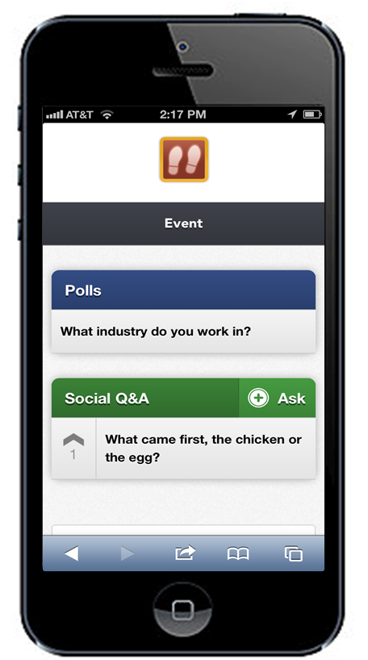
cb.cnf.io
Please bookmark now!
Polls: Respond to questions
Social Q&A: Ask questions or vote for question.
Notes:
During Session Instructions: Participate Using Conferences i/o
(Note: Insert poll and social Q&A instructional slide at beginning of PPT slide deck.)
1. Poll Questions:
Navigate to https://cb.cnf.io on your mobile device (just like you would access any other website).
Respond to Polls when they appear on your screen.
2. Social Q&A:
Click the ‘+ Ask’ button to submit a question to presenter/moderator.
Up-Vote other questions by using the ^ arrow on the left-hand side of each question so “best” questions will move to top of the list.
Presenter will answer top questions at end of the session.
Note: Some sessions will not use this feature.
Before session begins: Welcome and Instructions
“Welcome everyone. We’re going to be using a product called Conferences i/o that will allow you to interact with us during this session.
With a mobile device (smartphone, tablet, laptop, etc.) please take 30 seconds right now, take out your device. go to https://cb.cnf.io . then bookmark the URL.
The URL is also being projected on the screen at the front of the room.
You can use this tool to respond to presenter polls, ask questions, and up-vote other attendees’ questions so the best questions move to the top of the list.
The presenter will answer the top questions at the end of the session.
Again that URL is https://cb.cnf.io
Speaker Note:
For the Social Q&A: Vote moves questions up in the list – speaker would say something like “I will answer top 5 questions at the end of the session. Please add questions and up vote the best questions so your favorite is on top.”

Slide 10
Live Content Slide
When playing as a slideshow, this slide will display live content
Social Q&A
Notes:
This is a live content slide. When playing this presentation as a slideshow, and as long as the Conferences i/ o Windows PowerPoint Add - In is installed, this slide will be where live content appears. Please leave the following Slide Code tag in place: <cnf>RF16PEWX92T4E463</cnf>.

Slide 11
What Questions Do You Have?
Greg Davis, CPA
Partner, Tax Services 757.228.7030
gdavis@cbh.com

